Slide 1
Varactor Diode
By
Soham Yugraj Tiwari
Amaan Ayyub Nalband
Shravan Vijaypratap Singh
Pratik Rajesh Jade
(Roll no’s A69, A70, A71, A72)
Faculty Name: Ms. Shubhangi Lohakpure
FY B.Tech: Div A

Slide 2
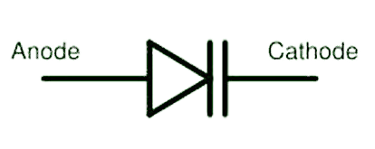
What is a Varactor Diode?
Varactor diode is one kind of semiconductor microwave solid-state device and the applications of this diode mainly involve in where variable capacitance is preferred which can be accomplished by controlling voltage. These diodes are also named as varicap diodes. Even though the outcome of the variable capacitance can be shown by the normal P-N junction diodes, but these diodes are chosen for giving the desired capacitance changes as they are special types of diodes. Varactor diodes are specifically fabricated and optimized such that they permit a high range of changes in capacitance.
The different types of Varactor diodes are available in the market such as hyper abrupt, abrupt and gallium-arsenide Varactor diodes. The symbol of the Varactor diode is shown in the above figure that includes a capacitor symbol at one end of the diode that signifies the characteristics of the variable capacitor of the Varactor diodes.
The symbol of the Varactor diode looks like a common PN- junction diode that includes two terminals namely the cathode and the anode. And at one end this diode is inbuilt with two lines that specify the capacitor symbol.

Slide 3
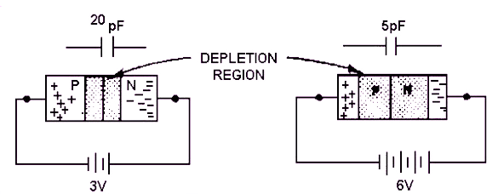
Working of a Varactor Diode
To know the Varactor diode working principle, we must know the function of capacitor and capacitance. Let us consider the capacitor that comprises of two plates alienated by an insulator as shown in the figure.

Slide 4
We know that the capacitance of a capacitor is directly proportional to the region of the terminals, as the region of the terminals increases the capacitance of the capacitor increases.
When the diode is in the reverse biased mode, where the two regions of P-type and N-type are able to conduct and thus can be treated as two terminals. The depletion area between the P-type & N-type regions can be considered as the insulating dielectric. Therefore, it is similar to the capacitor shown above.
The volume of the depletion region of the diode varies with change in reverse bias. If the reverse voltage of the diode is increased, then the size of the depletion region increases. Likewise, if the reverse voltage of the Varactor diode is decreased, then the size of the depletion region decreases. Hence, by changing the reverse bias of the diode the capacitance can be changed.

Slide 5
Characteristics of Varactor Diode
1
2
These diodes significantly generate less noise compared to other diodes.
The cost of these diodes is available at lower and more reliable also.
3
4
These diodes are very small in size and very lightweight.
There is no use when it is operated in forwarding bias.

Slide 6
Applications of Varactor Diode
Varactor diodes are widely used within many RF designs. They provide a method of varying the capacitance within a circuit by the application of a control voltage. This gives them an almost unique capability and as a result varactor diodes are widely used within the RF industry.
Although varactor diodes or varicap diodes can be used many different circuits, they find uses in two main areas:
Voltage controlled oscillators, VCOs: Voltage controlled oscillators are used in many different RF designs. One major area is for the oscillator within phased locked loops. In turn these can be used as FM demodulators or within frequency synthesizers. The varactor diode is a key component within the voltage controlled oscillator.

Slide 7
RF filters: Using varactor diodes makes it possible to tune filters. Tracking filters may be needed in receiver front end circuits where they enable the filters to track the incoming received signal frequency. Again this can be controlled using a control voltage. Typically this might be provided under microprocessor control via a digital to analogue converter.
Frequency & phase modulators: Varactor diodes can be used in frequency and phase modulators. In frequency modulators they can be placed across the resonant element within the generator and the audio applied to the diode. In this way its capacitance will vary in line with the audio, causing the signal frequency to shift up and down in line with the capacitance variations, and hence in line with the audio. For phase modulation, the fixed frequency signal can be passed through a phase shift network, and the diode incorporated int his. Again, audio is applied to the diode and this causes the phase to shift in line with the audio variations.
In terms of the circuits in which varactor diodes are used, these include within the oscillators of phase locked loops and hence many types of frequency synthesizer, within filters where the control of the filter frequency needs to be controlled digitally. They can even be used in some types of harmonic multiplier circuits as well.

Slide 8
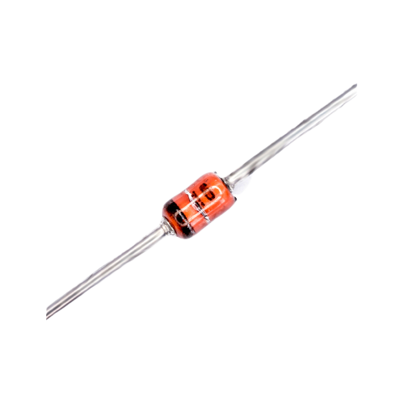
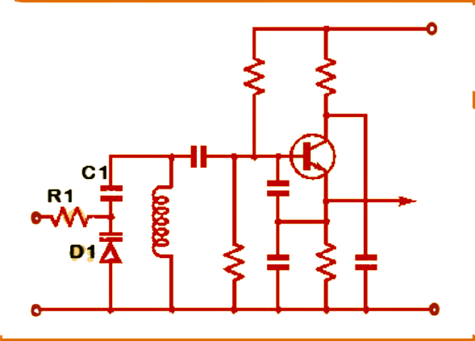
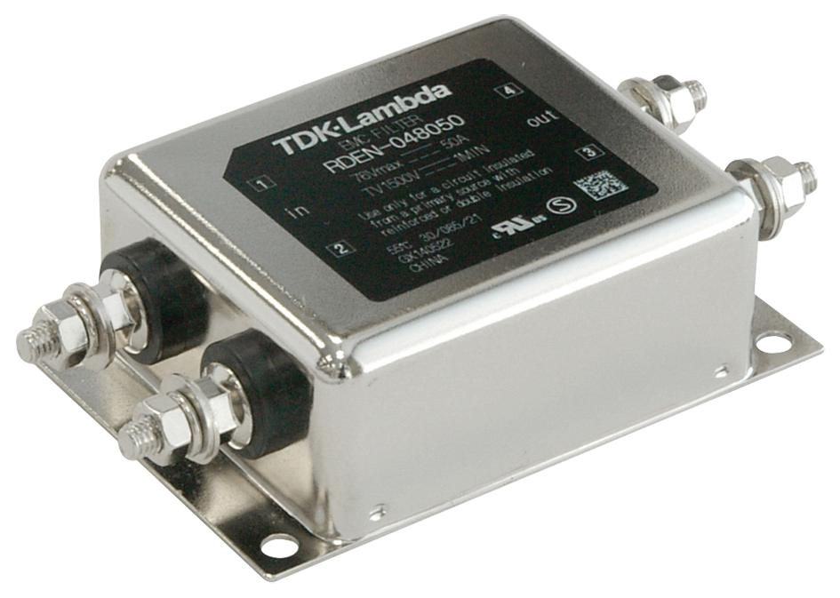
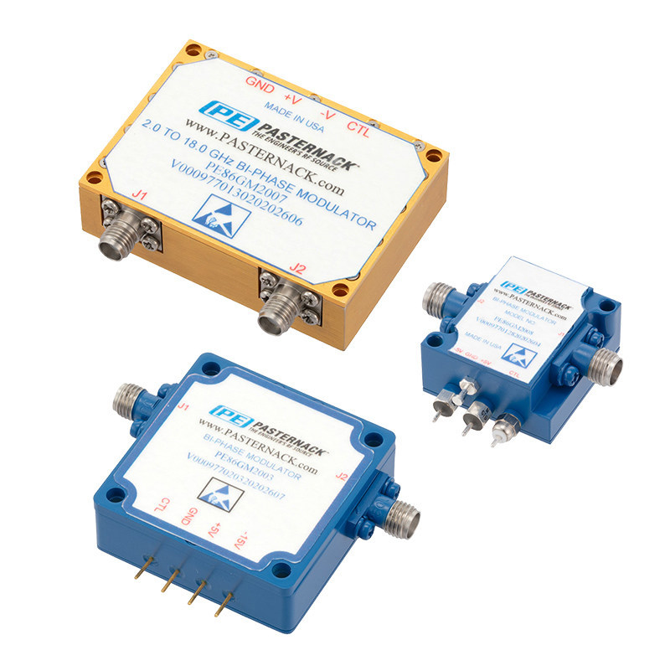
Varactor Diode
Voltage controlled oscillators, VCOs
RF filters
Frequency & phase modulators

Slide 9
Thanks
Reference-
https://www.elprocus.com/varactor-diode-working-and-applications/
https://www.electronics-notes.com/articles/electronic_components/diode/varactor-varicap-diode.php

